Slide 1

Interpreting Results and Prediction Methods
AARUSH AMBATI

Slide 2
Introduction
Welcome to the presentation on predictive modeling for voter turnout.
Our goal is to analyze voter behavior and predict voter turnout for the 2014 general election using machine learning techniques.
We utilized four powerful machine learning algorithms: Logistic Regression, Random Forest, Support Vector Machine (SVM), and XGBoost.
These models enable us to understand voter behavior and identify key factors influencing voter turnout.

Slide 3
Model Training
Our modeling process involves several steps, starting with data preprocessing and feature selection.
Feature selection techniques such as L1 regularization, feature importance, and coefficients analysis were employed for each model.
Visualizations of feature importance were generated to understand the impact of different features on voter turnout.
The training process ensures that our models learn from the data and make accurate predictions.

Slide 4
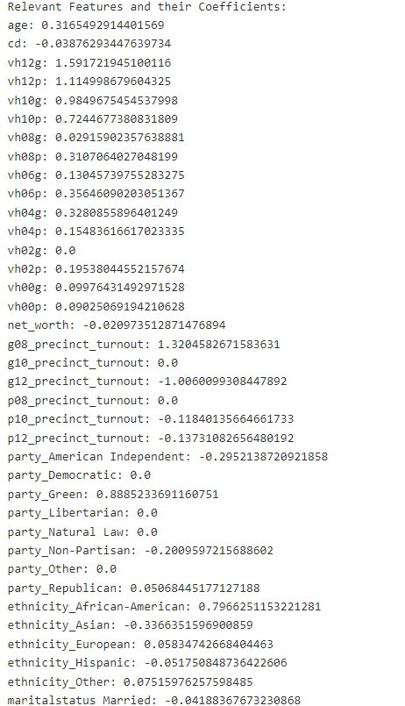
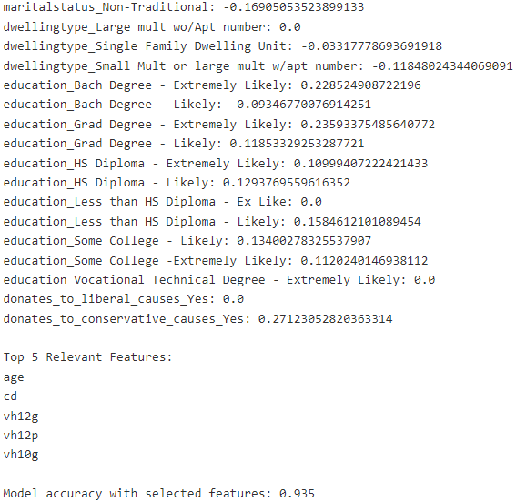
Relevant Features and their Importance
All the relevant features with their coefficients are given and also the accuracy of the respective model is mentioned too

Slide 5
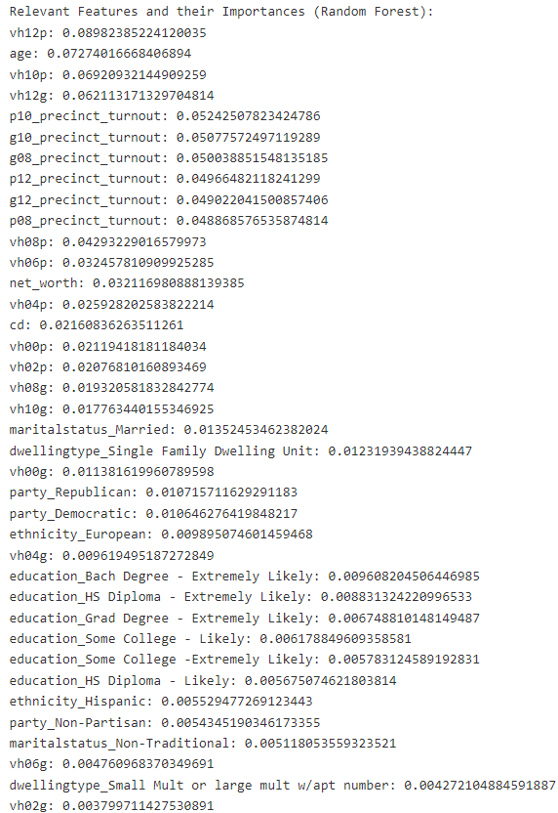
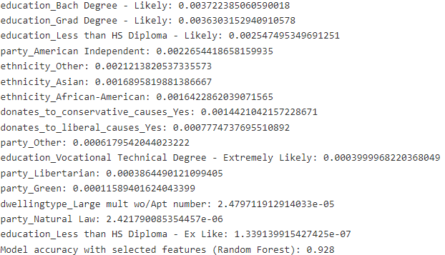
Relevant Features and their Importance
All the relevant features with their coefficients are given and also the accuracy of the respective model is mentioned too

Slide 6
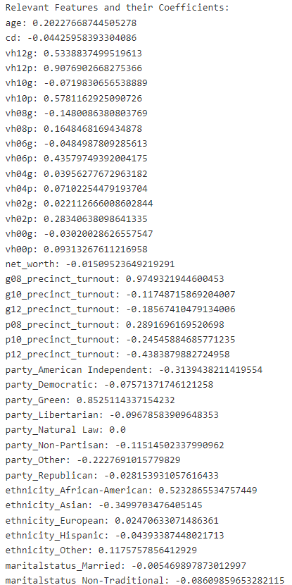
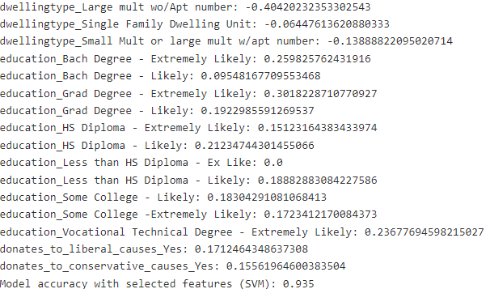
Relevant Features and their Importance
All the relevant features with their coefficients are given and also the accuracy of the respective model is mentioned too

Slide 7
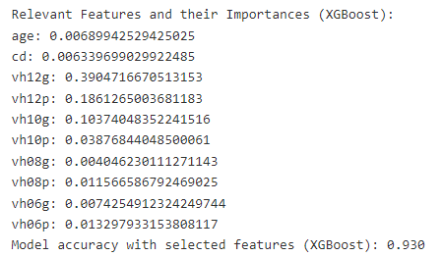
Relevant Features and their Importance
All the relevant features with their coefficients are given and also the accuracy of the respective model is mentioned too

Slide 8
Model Evaluation
Evaluating model performance is crucial to assess their predictive power.
The accuracy scores for each model are as follows:
Logistic Regression: 93.5%
Random Forest: 92.8%
SVM: 93.3%
XGBoost: 93.0%
These high accuracy scores indicate the effectiveness of our models in predicting voter turnout.
Additional evaluation metrics, such as precision, recall, and F1-score, can provide further insights into model performance.

Slide 9
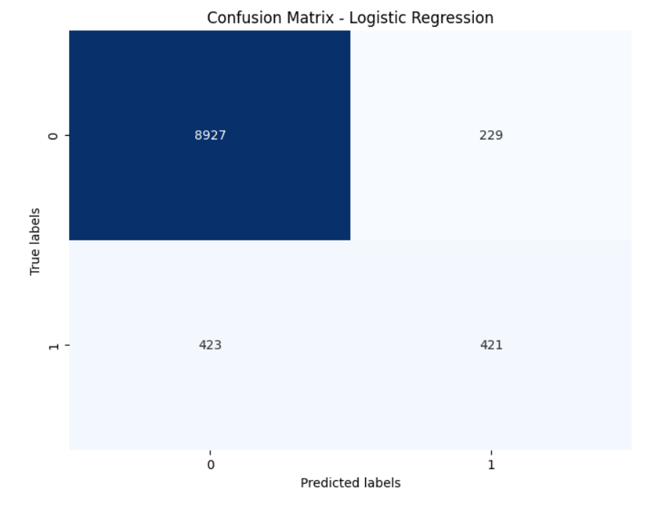
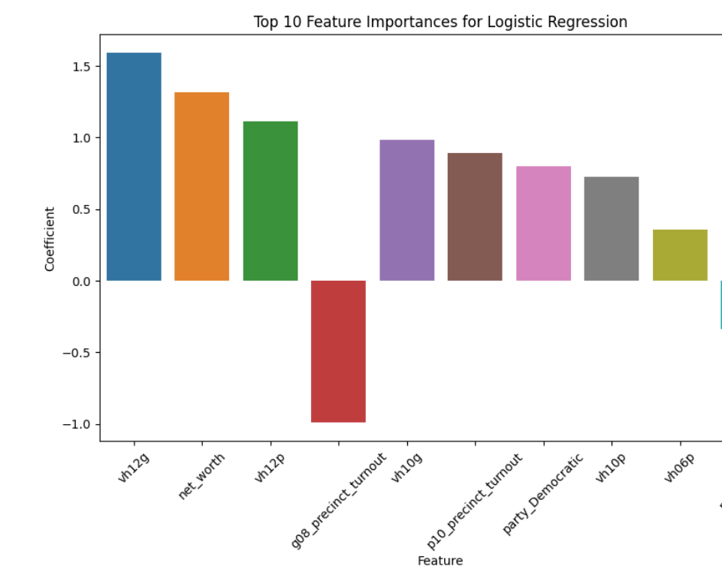
Visualisation(LR)

Slide 10
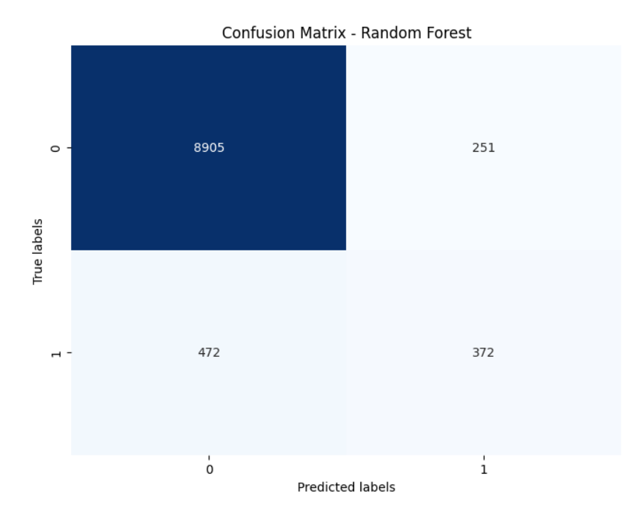
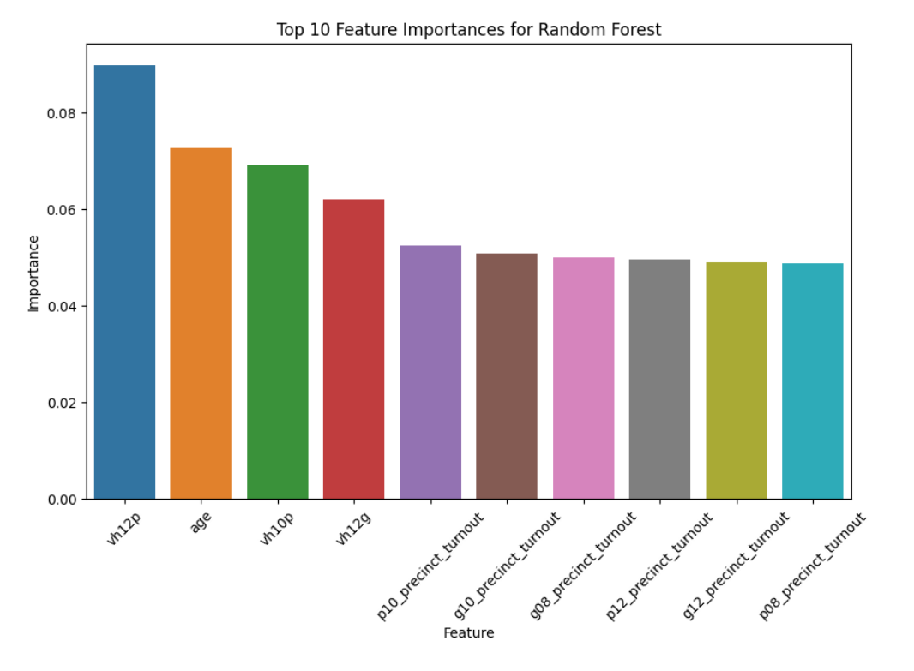
Visualisation(RF)

Slide 11
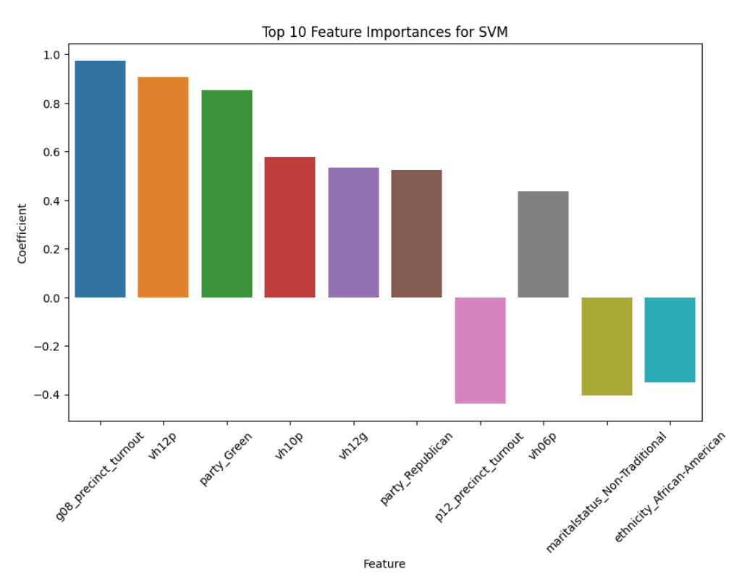
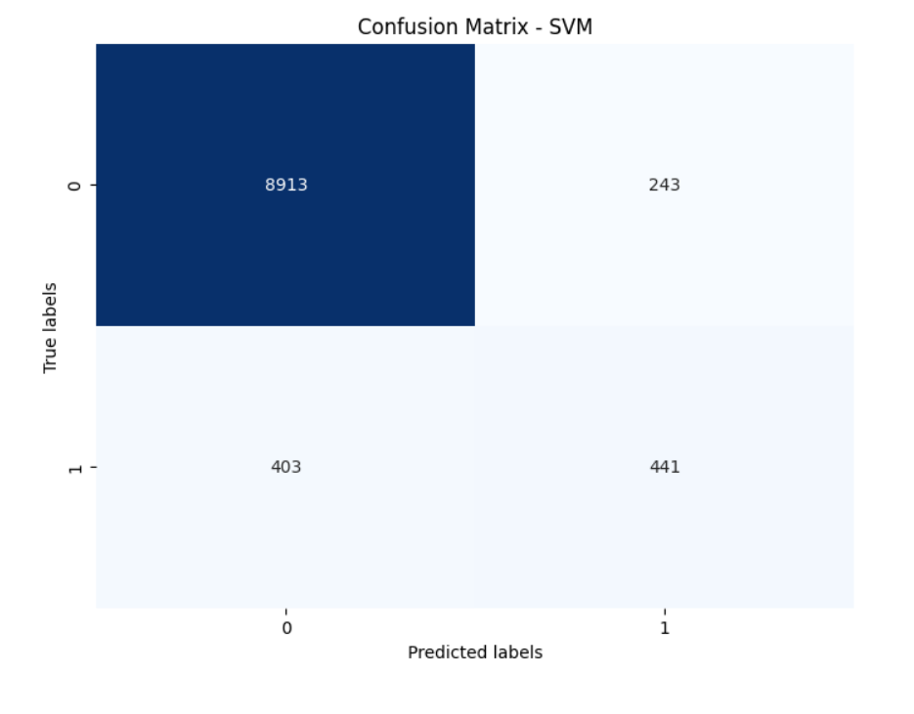
Visualisation(SVM)

Slide 12
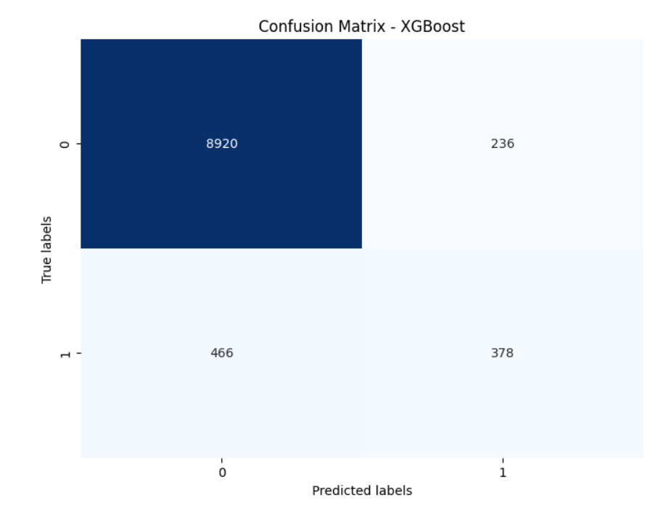
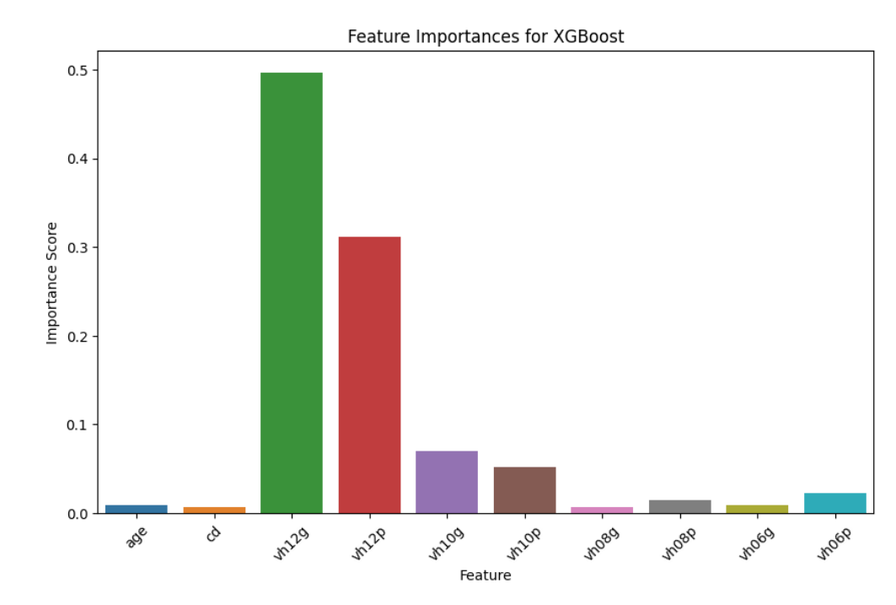
Visualisation(XGB)

Slide 13
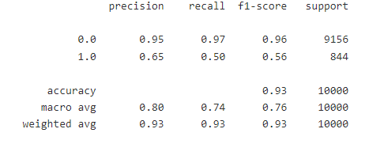
Classification Report
It summarizes the performance of a classification model by providing metrics such as precision, recall, F1-score, and support for each class label.

Slide 14
Result Analysis
Our analysis reveals significant insights into voter behavior and turnout.
Feature importance analysis highlights the key factors influencing voter turnout, such as demographics, voting history, and precinct turnout.
Confusion matrices visualize the model's performance in predicting voter turnout, showing the distribution of true positive, true negative, false positive, and false negative predictions.
These findings provide valuable insights for political campaigns to target specific demographic groups and precincts effectively.

Slide 15
Conclusion
In conclusion, our predictive modeling approach offers valuable insights into voter behavior and turnout for the 2014 general election.
The high accuracy of our models demonstrates their effectiveness in predicting voter turnout.
Moving forward, we plan to refine our models further and explore their deployment in real-world scenarios.
By leveraging predictive modeling, we aim to empower political campaigns with actionable insights to maximize voter engagement and participation.

